Slide 1
DM_CH1-4.3 Extension
Alexander Spivey

Slide 2
Question: If block_1.csv had a correctly classified instance rate of 99.983%, what will other blocks score; what will be the resulting “best” decision tree*
*using training set as test (for cpu** and time sake)
**I tried to test all blocks in one knowledgeflow run

Slide 3
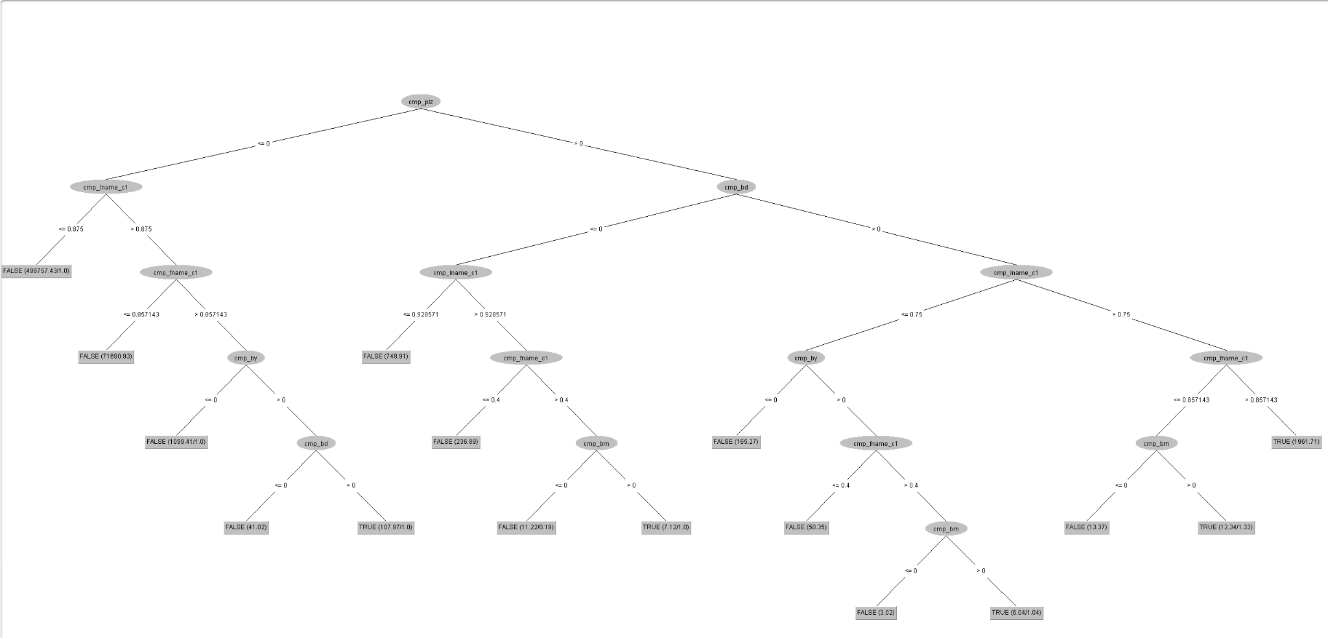

Slide 4
99.999%
Correctly classified instances

